Slide 1
Weekly meeting
11 14 2024
Ty Bottorff

Slide 2
Outline
NCI irAE follow ups
AbATE manuscript planning

Slide 3
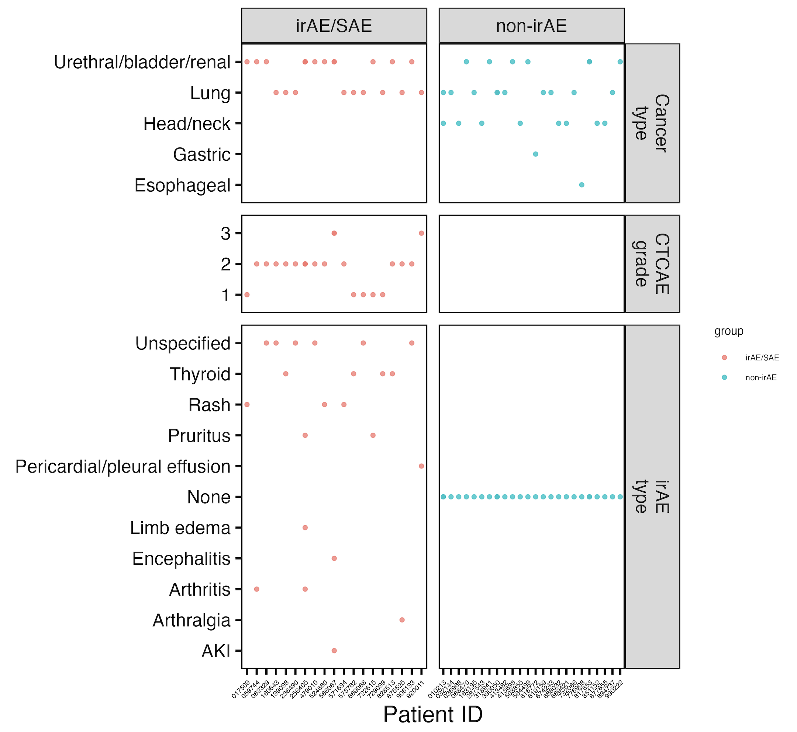
NCI irAE cohort summary
Notes:
Should also try regressing out effect of cancer type? Different in irAE groups…

Slide 4
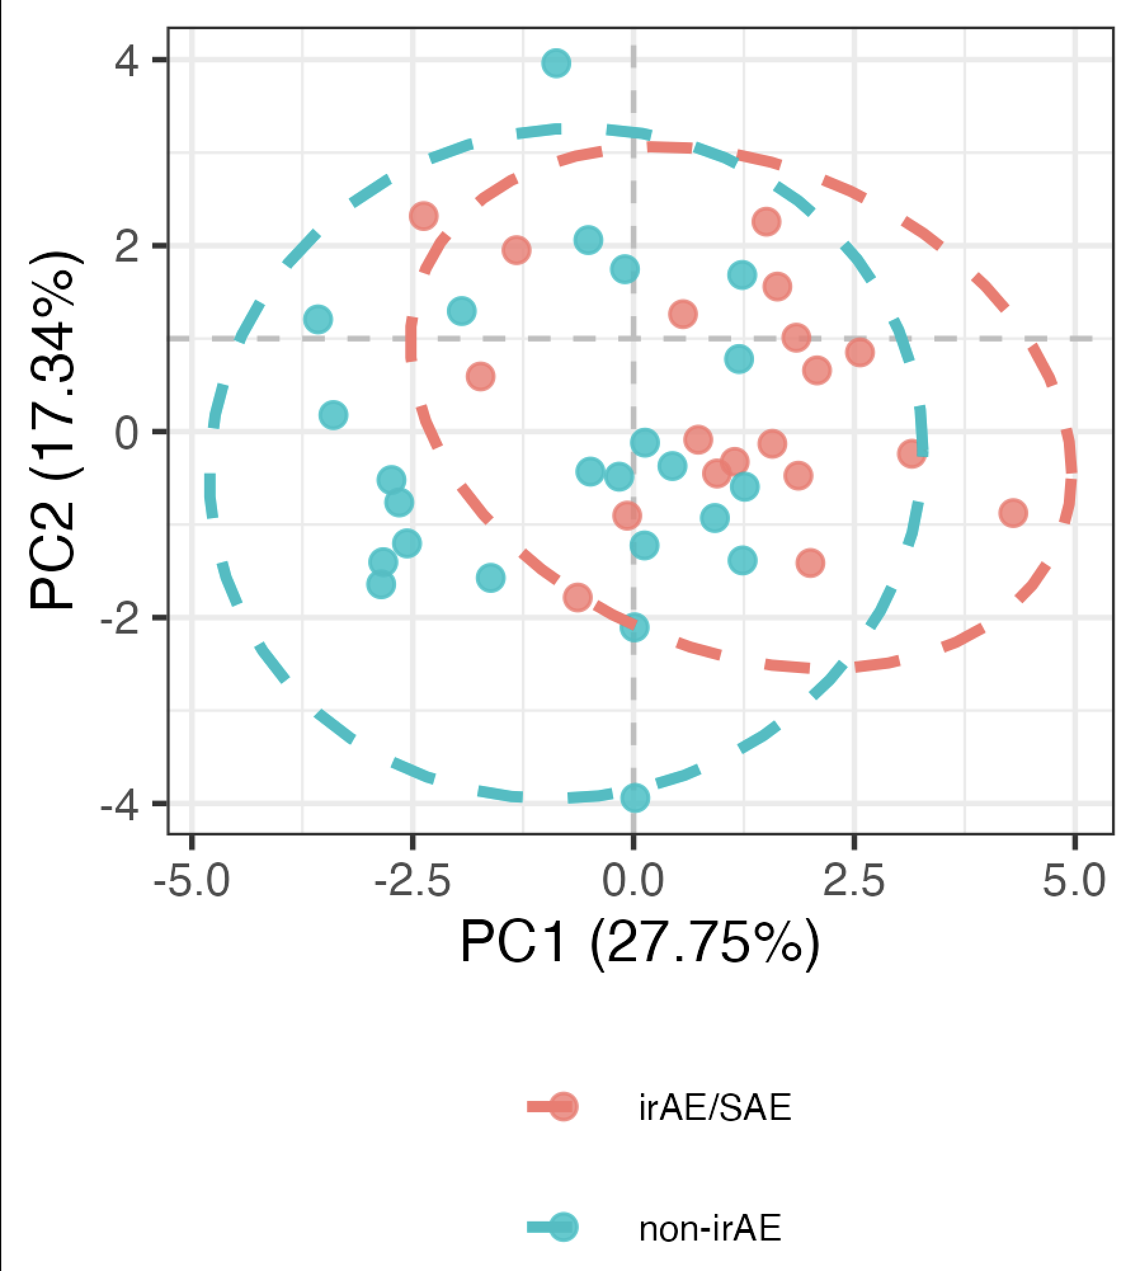
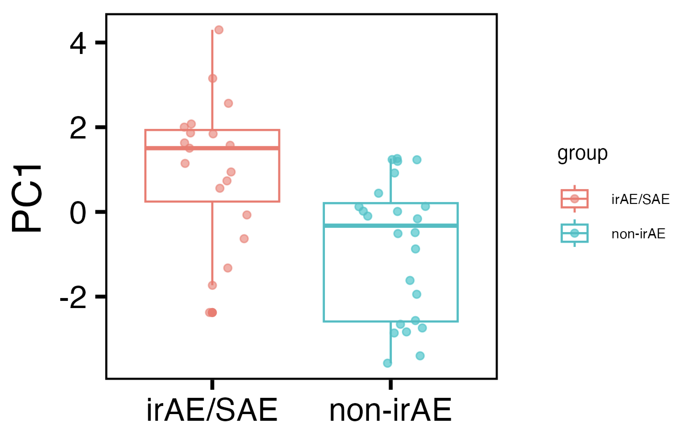
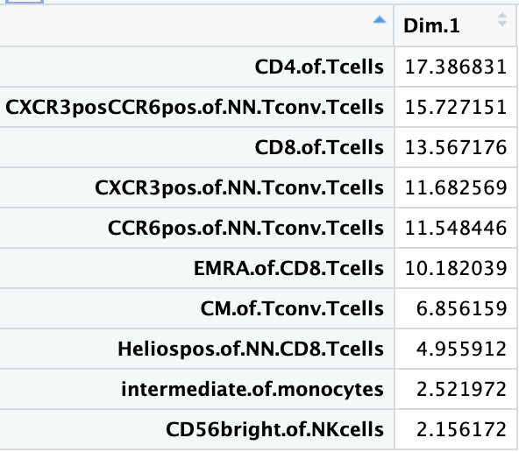
Baseline immunotypes do differ between irAE groups in PC1 of PCA using top features
PC1: p = 0.001
Notes:
Batch corrected, logit transformed, Z-scored freqs
Top 13 features here chosen from stats of batch-corrected logit transformed z-scored data unadjusted pval < 0.1
Directionality in PC space is arbitrary, so refer to mean module slide (next slide) for directionality

Slide 5
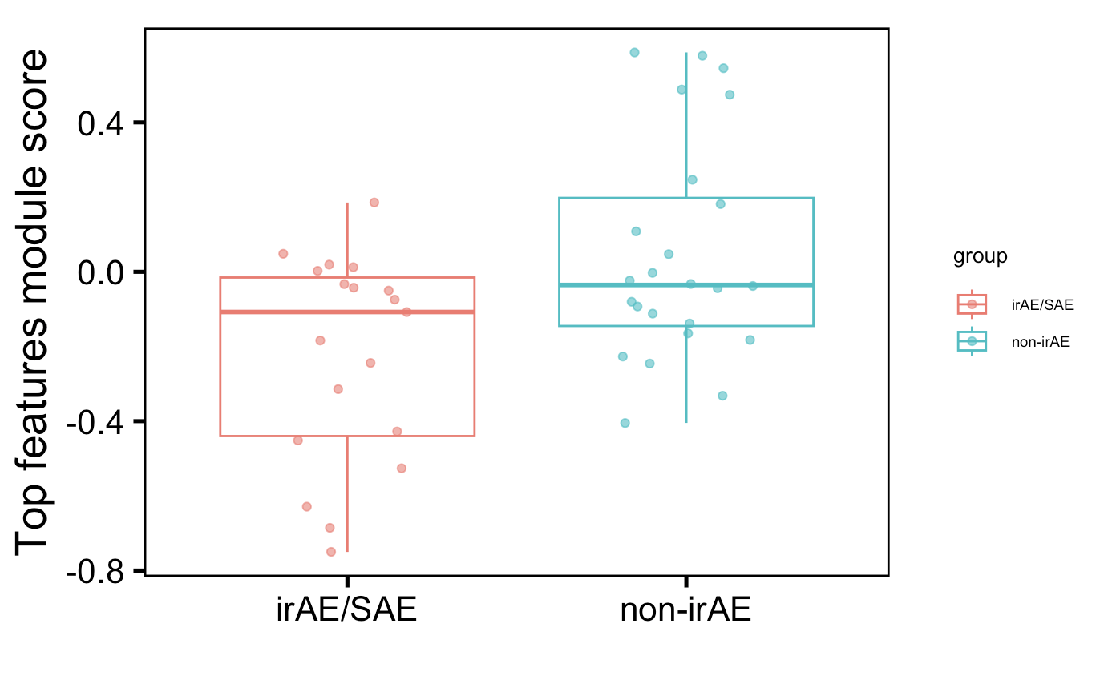
Also observe difference in mean module of top features (using more features than before)
p = 0.03
Notes:
Batch corrected, logit transformed, Z-scored freqs
Top 13 features here chosen from stats of batch-corrected logit transformed z-scored data unadjusted pval < 0.1

Slide 6
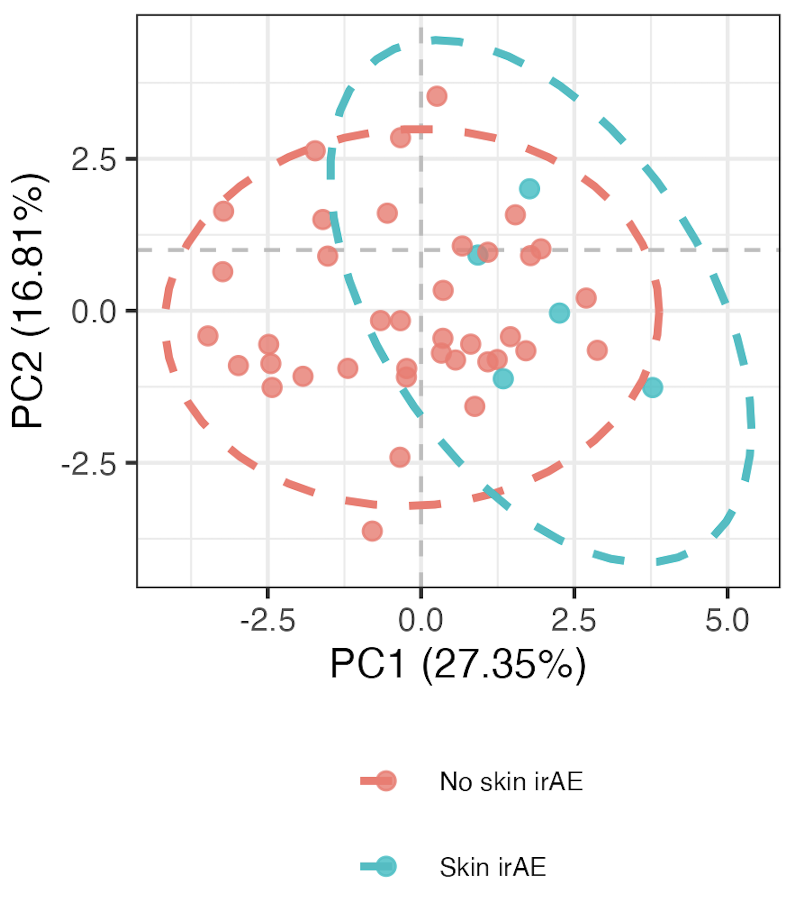
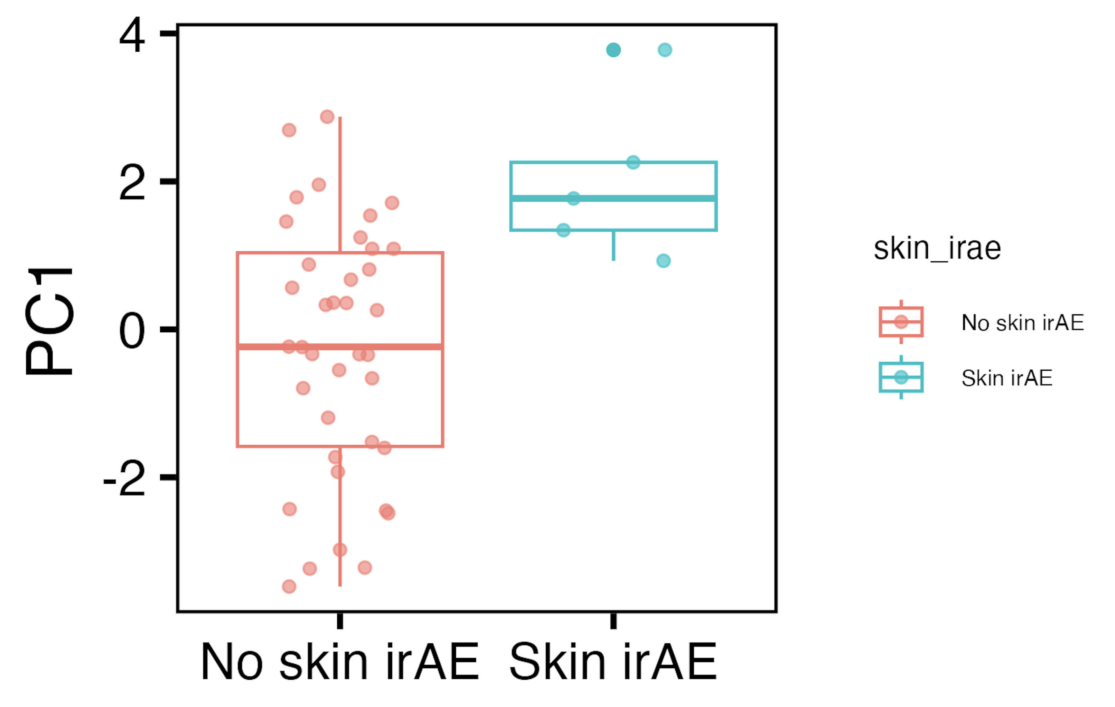
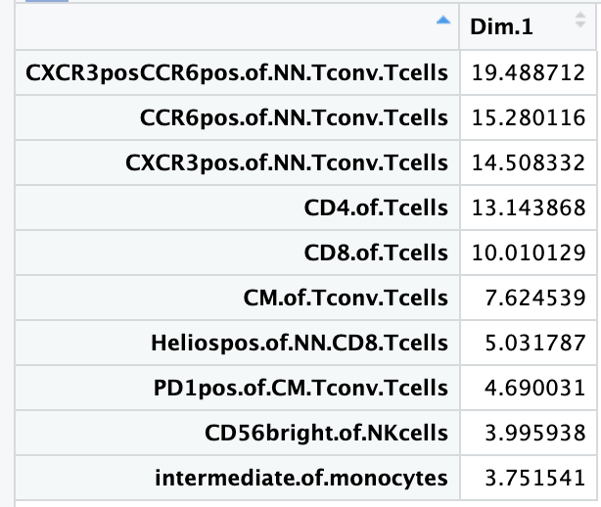
Baseline immunotypes do differ between skin irAE groups in PC1 of PCA using top features
PC1: p = 0.005
Notes:
Batch corrected, logit transformed, Z-scored freqs
Top features here chosen from stats of batch-corrected logit transformed z-scored data unadjusted pval < 0.1

Slide 7
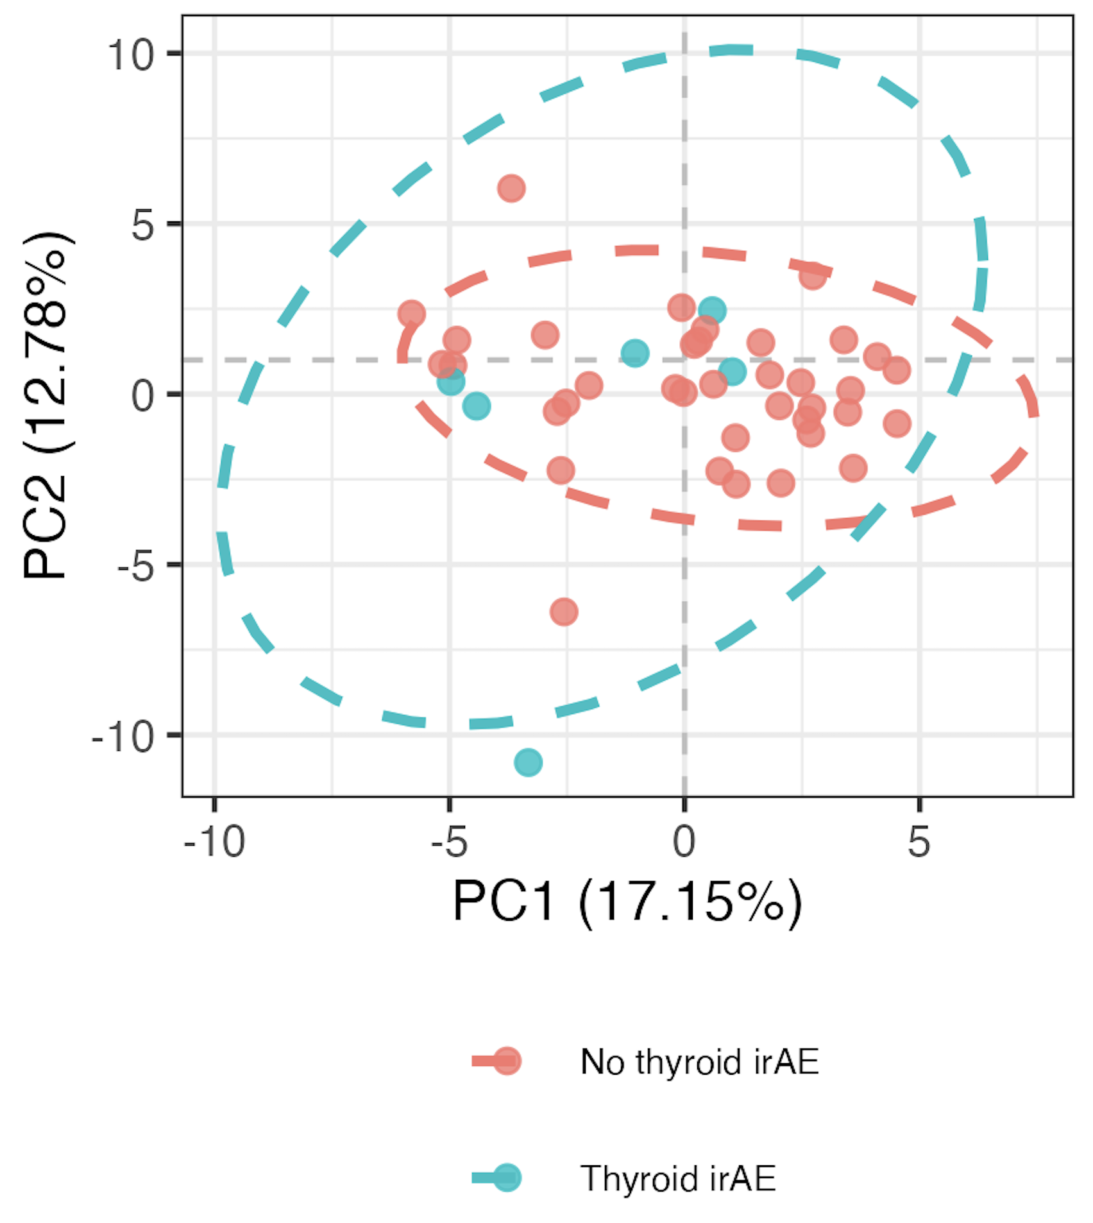
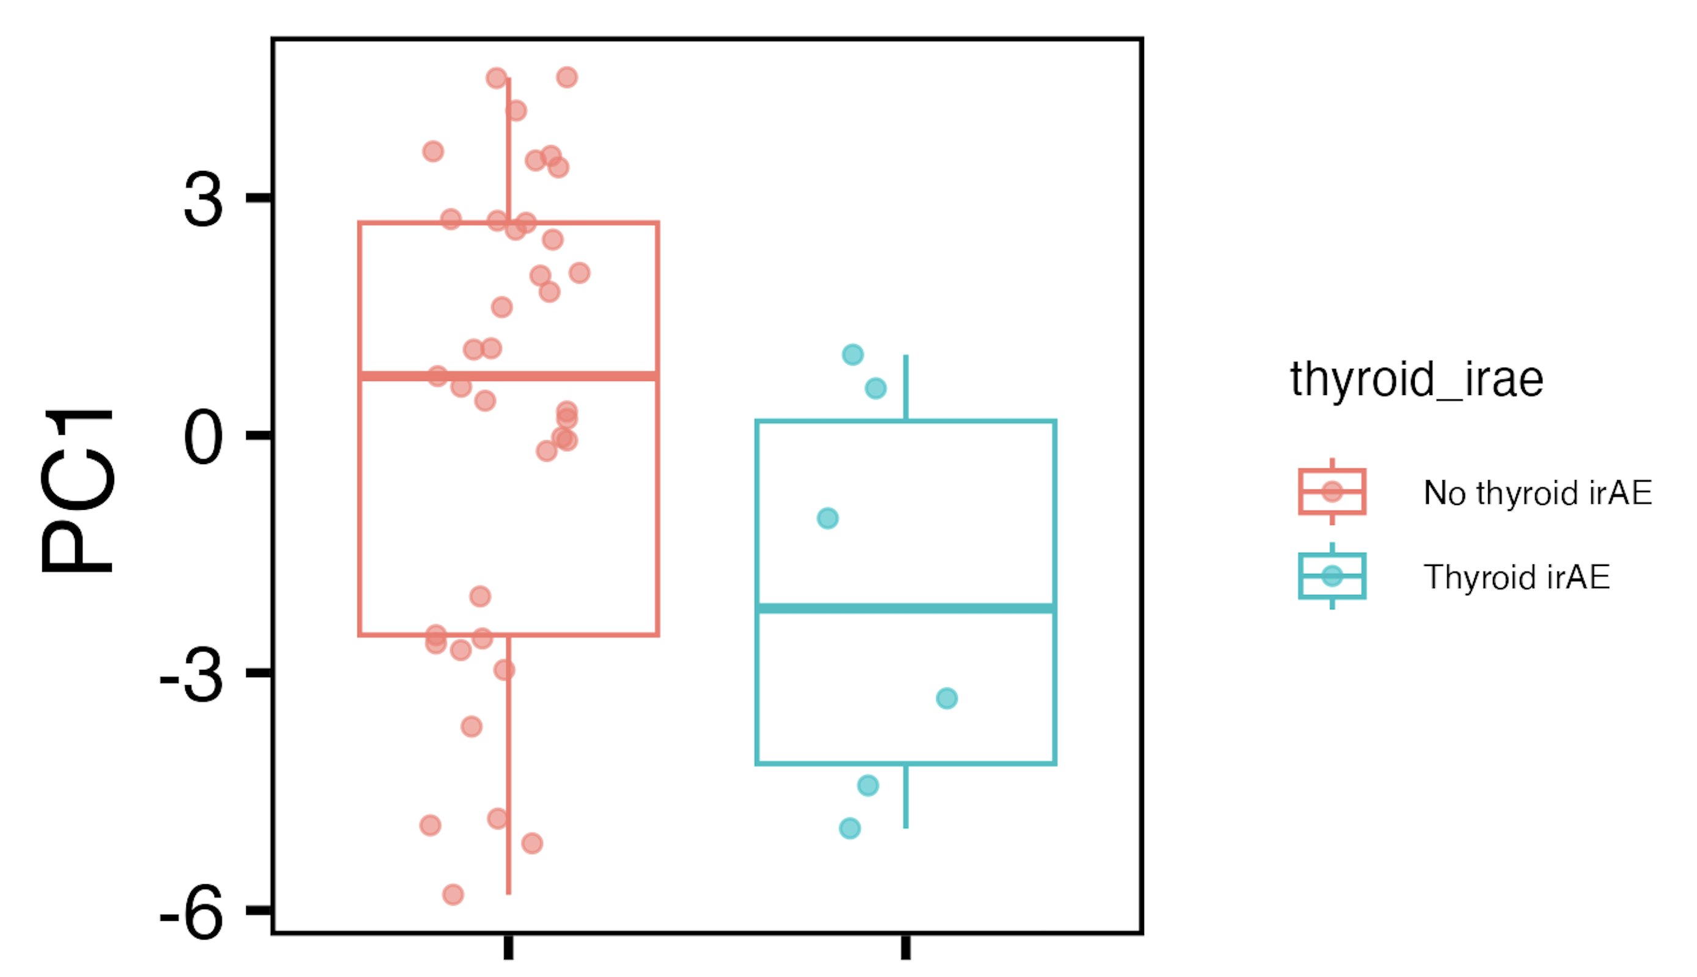
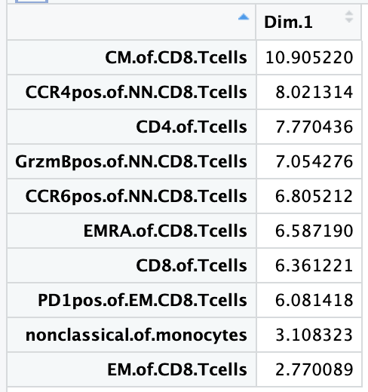
Baseline immunotypes slightly differ between thyroid irAE groups in PC1 of PCA using all features
PC1: p = 0.08
if including OOR in thyroid irAE, see no significant differences
Notes:
Batch corrected, logit transformed, Z-scored freqs
ALL features here

Slide 8
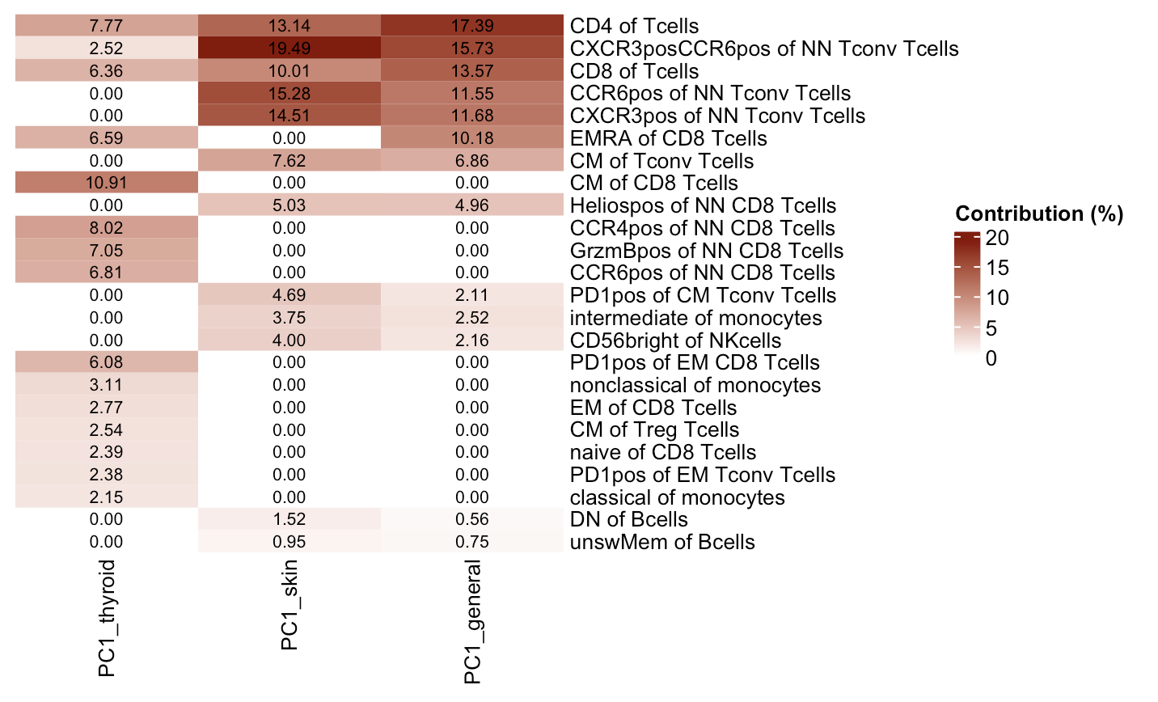
Features contributing to PC1s in 3 baseline irAE comparisons
Notes:
Thyroid comparison coming from all features, other 2 from top features do basically overlap (general just has a 13th feature that skin doesn’t)

Slide 9
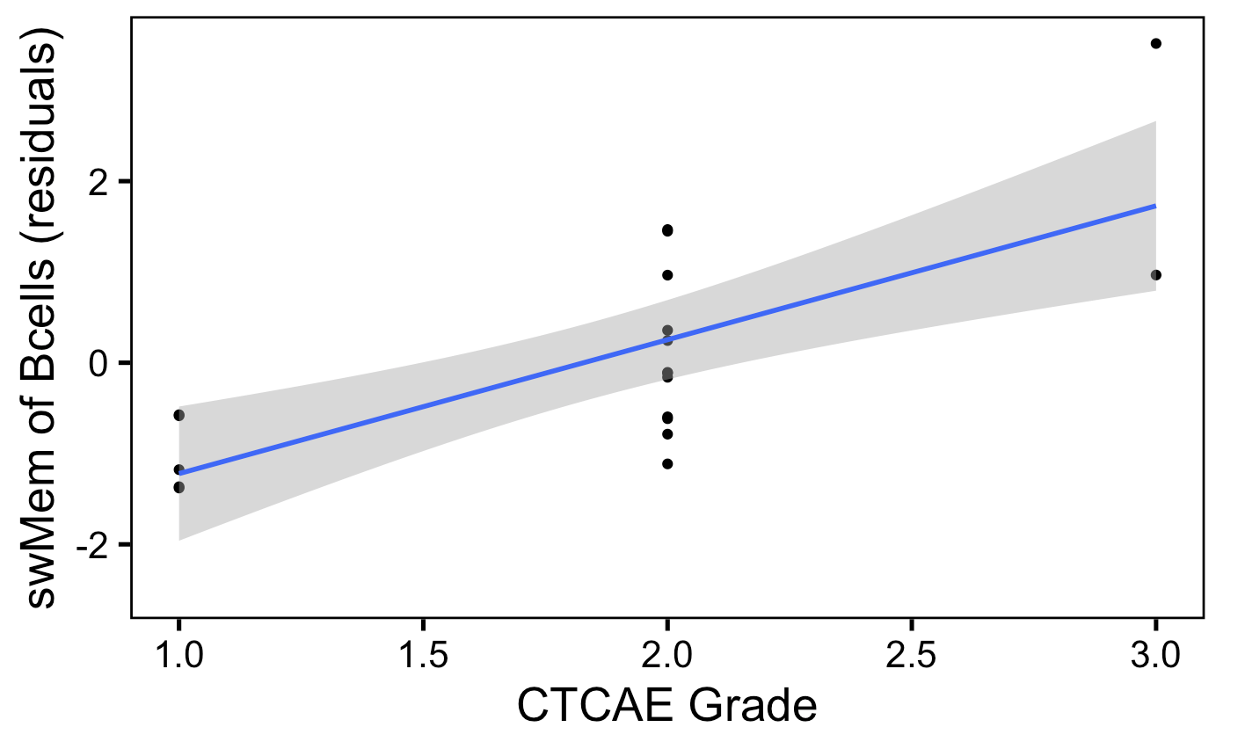
Baseline swMem of Bcells (batch corrected) freq weakly correlates with irAE severity
padj = 0.06
Notes:
Batch corrected, logit transformed, Z-scored freqs
May want to re-do with 0 score for no irAE…

Slide 10
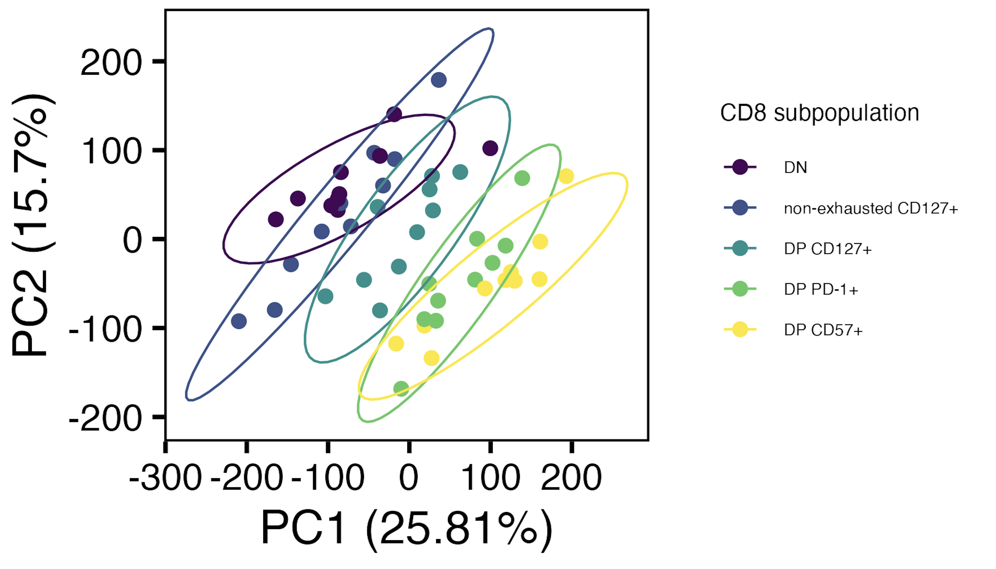
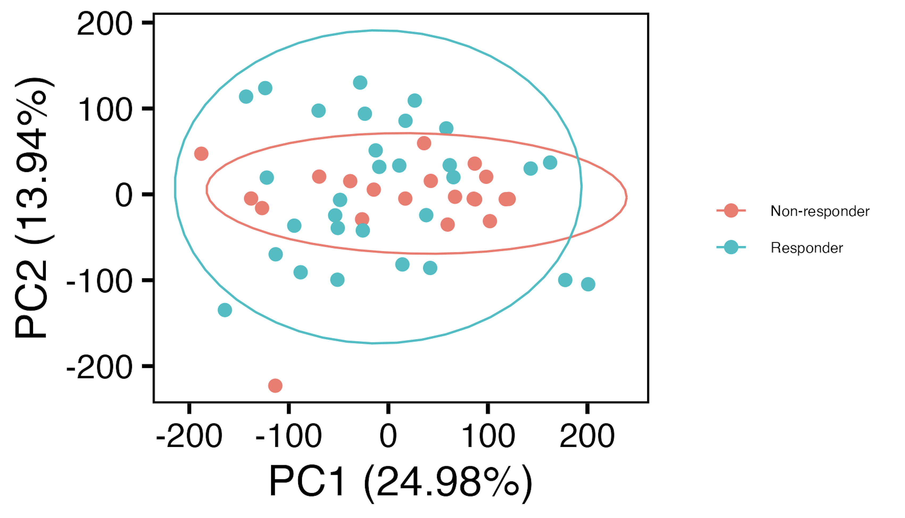
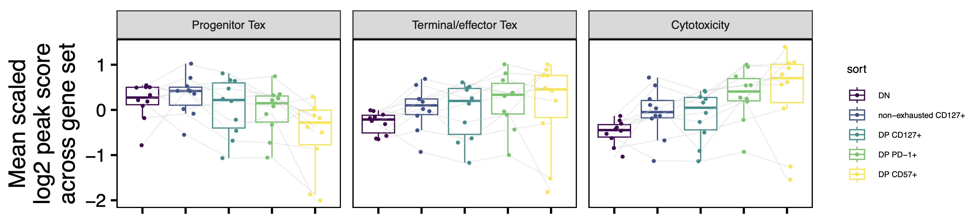
Proposed main fig 1 for AbATE manuscript: epigenetic profiles of non-naïve CD8 subpopulations are distinct
A
B
D: heatmap version of E
C: DPs show signs of exhaustion (vs. DN)
E
E: complementary mean gene coverage plots
Related supplemental figs:
- potential weak effect of telomerase genes more accessible in non-exhausted vs. DP CD127⁺
- potential weak effect of JAK/STAT genes more accessible in CD127⁺ vs. DN
- potential weak effect of purine metabolism genes more accessible in DP CD127⁺ vs. DP CD127⁻
- complementary evidence for prog/term Tex split in HC + T1D scRNAseq/scTCRseq dataset
- Homer results (not strongly consistent/inconsistent with prog/term Tex split)

Slide 11
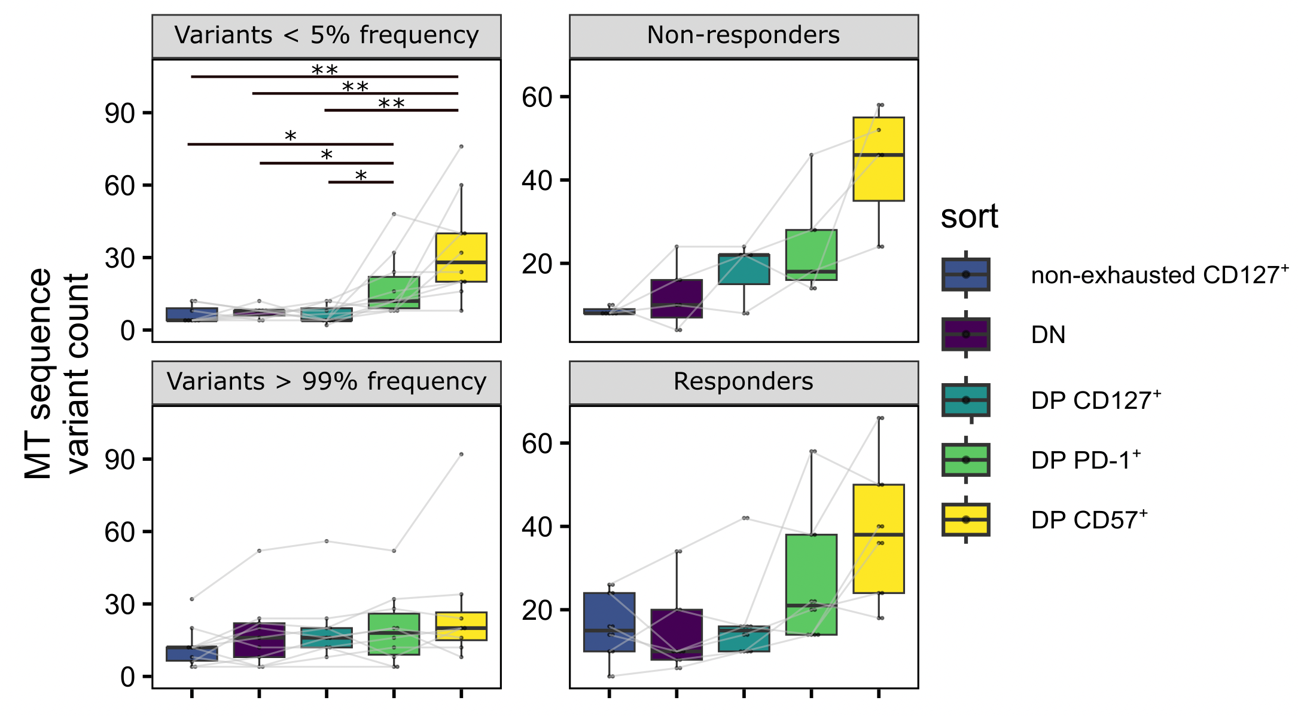
Proposed main fig 2 for AbATE manuscript: MT SNVs inform directionality in differentiation pathway
A: MT SNVs (total) boxplot
B: MT SNVs (total) boxplot R vs. NR
C: MT SNVs low vs. high freq
D: MT SNVs low vs. high freq (R vs. NR): new analysis
E: MT SNV sharing upset plot
Related supplemental fig:
- % reads mapping to MT genome
- MT SNV QC: publicity, position of SNVs in MT genome
- bimodal distribution of MT SNV freqs
- complementary analyses in Erin’s T1DAL (more SNVs in DP CD57⁺/PD-1⁺ vs. DN)

Slide 12
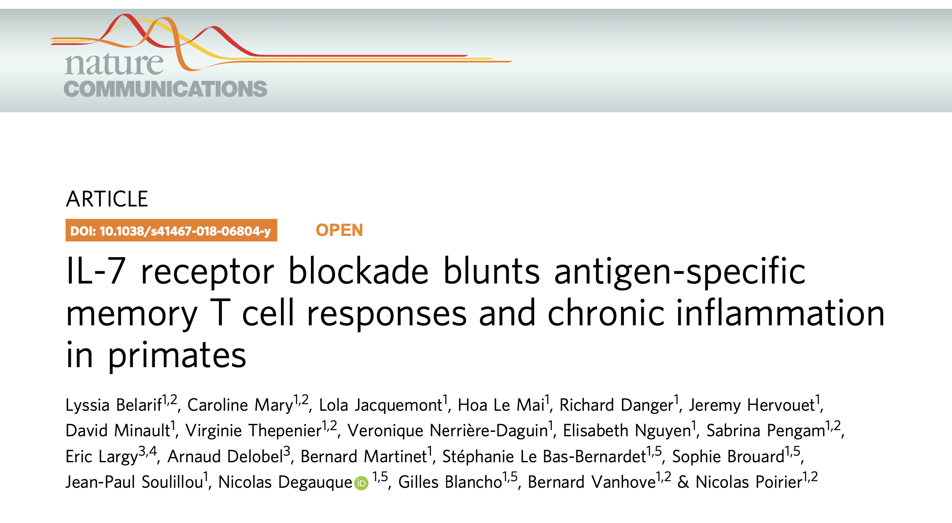
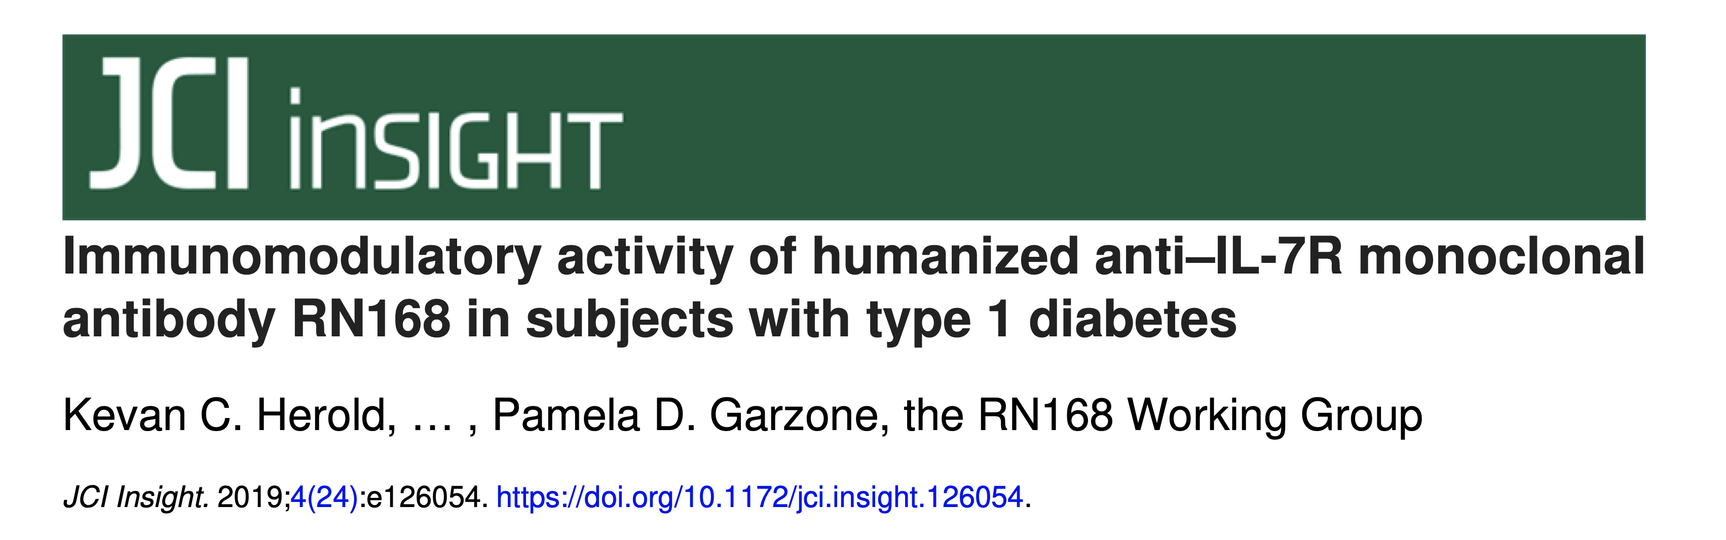
What else would be nice for AbATE manuscript…
MT SNVs, gaining sense of magnitude of counts
other ATACseq data (effects of infection, age…)
scRNAseq (like HC + untreated T1D project or Erin’s T1DAL, could also compare clonal inferences from MT SNVs to TCR clonotypes)
Another T1D dataset with CD127⁺ sort…
Mining public datasets, do we still see terminal DP PD-1⁺/CD57⁺ NN CD8s with IL7R blockade?
Notes:
This would probably be a supp figure tho…
Most other datasets just have NN CD8s… tricky to find CD127⁺ from that…

Slide 13
Conclusions
NCI irAE
do observe some immunotype differences at baseline between (skin/thyroid) irAE groups using combinations of features (means, PCs)
baseline swMem of Bcells freq weakly correlates with irAE severity
AbATE
CD127 levels slightly different between 2 progenitor clusters (TCM vs. TEM) in Erin’s data (data not shown), but not helpful in determining if DP CD8s arise from CD127⁻ and/or CD127⁺ precursors…

Slide 14
Next steps
NCI irAE
markers in NCI panel (like CD57) that weren’t gated for can still be analyzed (i.e. apply CD57⁺ IMPACD gate within DP subset)
IMPACD: making some progress importing flowJo and .fcs files into R…
AbATE manuscript, format as letter or include new analyses/experiments?
Notes:
Nat immun letter
JCI letter

